Slide 1


Off-Menu Podcast Database
Welcome to the dream restaurant
We’ve been expecting you for some time…
Notes:
Chose the off-menu podcast as it as it is a really interesting podcast where 2 Comedians host a guest each week and discuss their dream menu in the dream restaurant.
Podcast intro music plays on start.

Slide 2
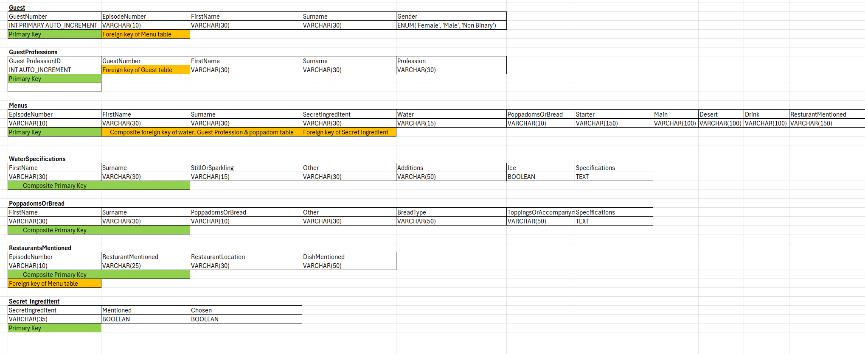
The Design
Visualisation:
Notes:
I struggled to visualise the tables, primary and foreign keys so I used a simple Excel brain dump to help me map it out
This also helped with consistency in data types by charting it out

Slide 3
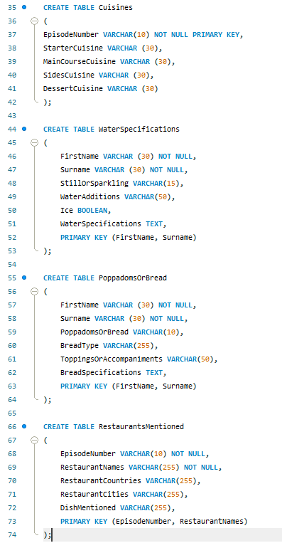
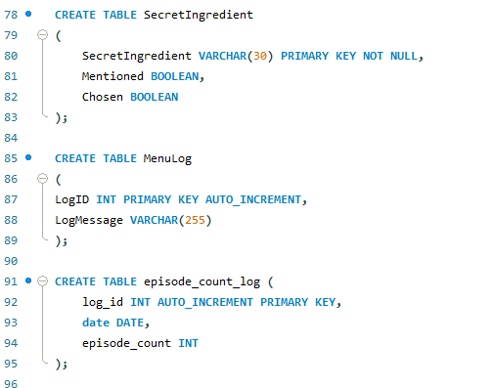
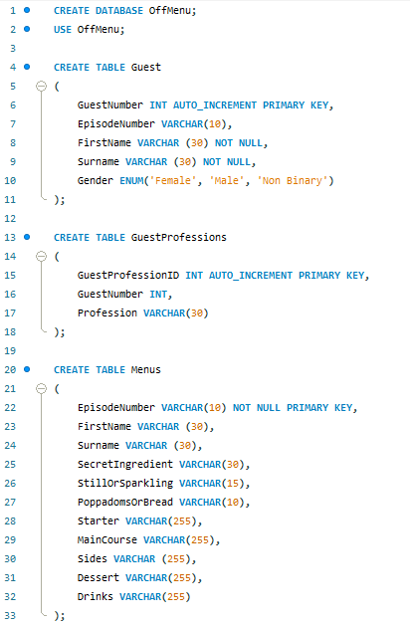
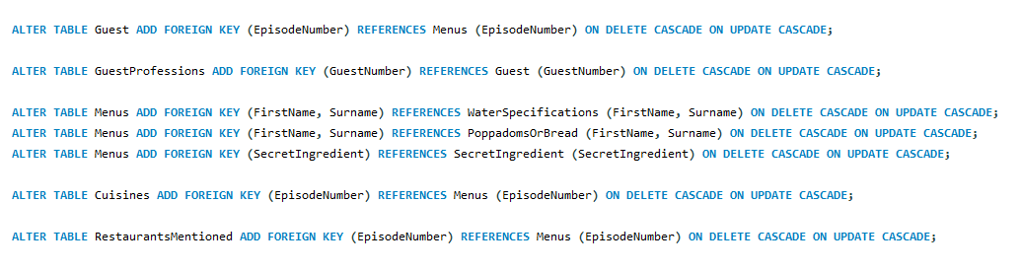
Creating the Tables
Notes:
Tables created with the help of my charts, making sure the data types and parameters were consistent where they had the same info.

Slide 4
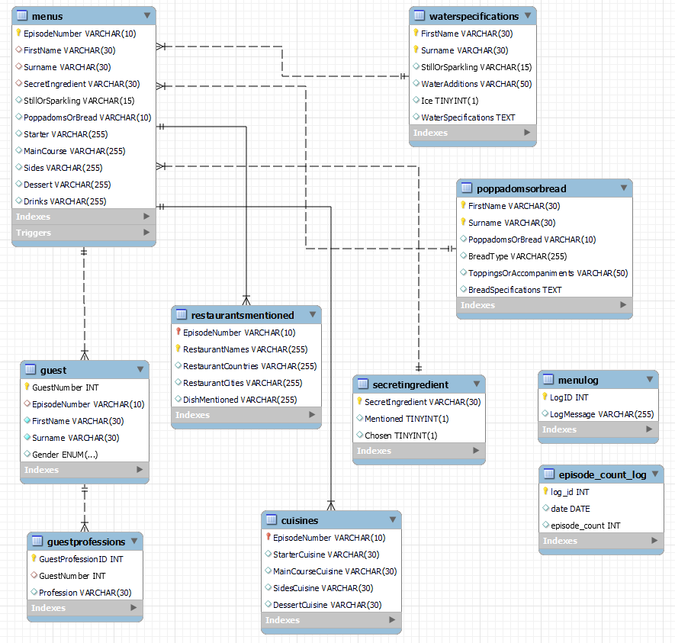
The final product
Notes:
ER diagram – the Menu table is the main table with the most foreign keys.
Menu and episode count log not linked as this is not required for this DB.

Slide 5
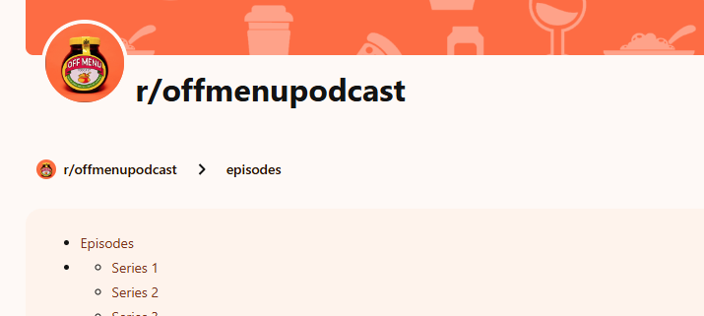
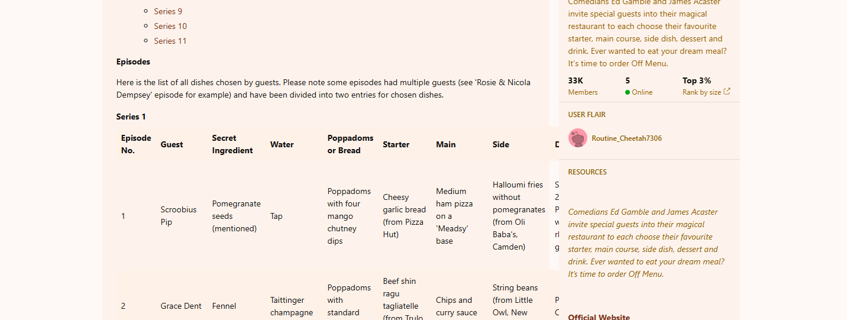

Inserting the data vs
The data...
Notes:
My challenge was finding a way to convert audio data into something I could use into a database!
I managed to source this Reddit post where someone has, an continues to update this!
The problem was it was unstructured and was going to be a nightmare manually inserting in – so I had to get creative

Slide 6
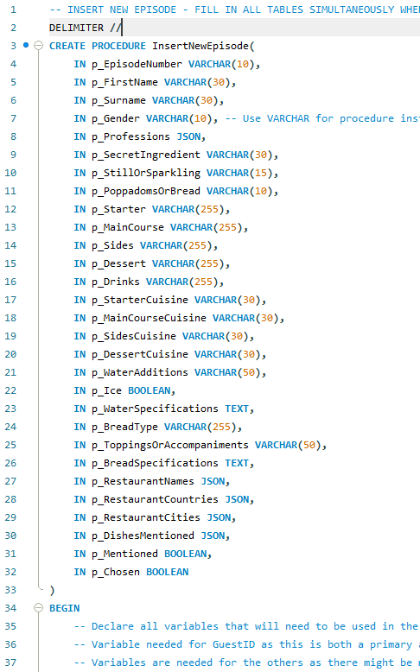
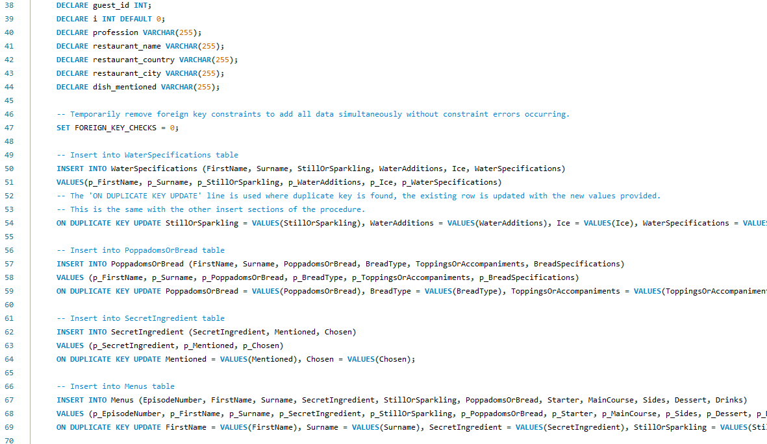
The mega procedure…
Notes:
Enter the mega procedure!
This was a labour of love/hate but worth it in the end.
I started by setting the parameters of the distinct columns that were needed – this was to avoid duplication of work and to preserve data integrity for clumns with the same data
I next declared the variables I would use in my procedure.
I encountered issues with foreign key constraints when simultaneously add data to multiple data fields, so I found the solution by temporarily turning off foreign key constrints.
I then entered data into the relevant tables using the input arguments.
ON DUPLICATE was added for error handling where duplicate data was being entered and throwing errors.

Slide 7
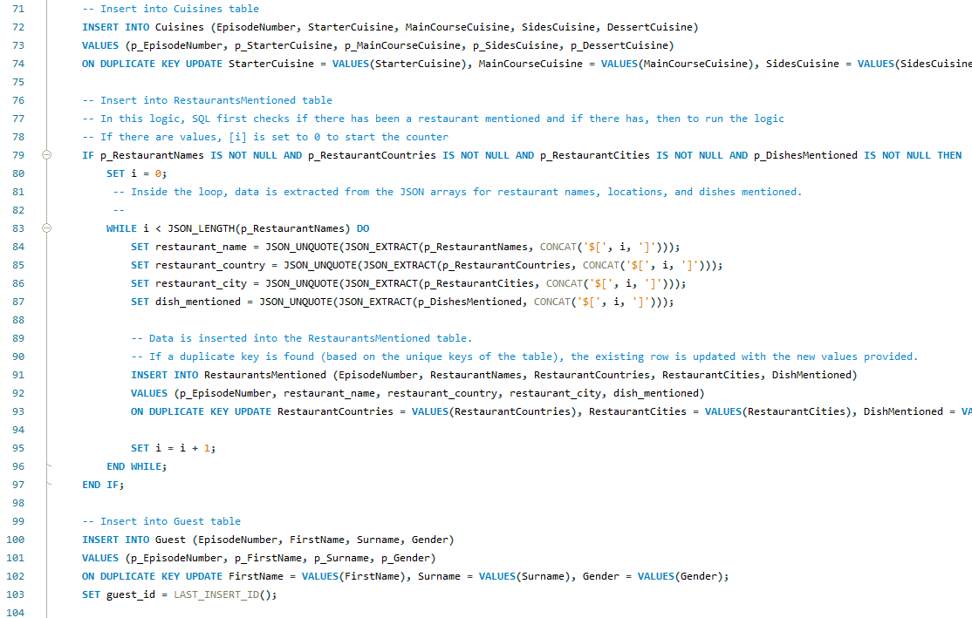
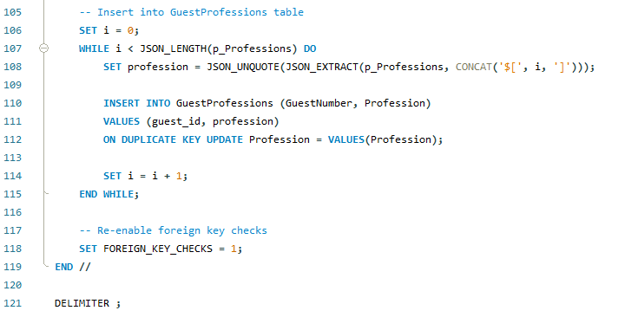
The mega procedure cont…
Notes:
For the restaurant’s table, as there are not always restaurants mentioned, an IF statement first checks if there is data in the field
If there is, then a WHILE loop, iterates over the restaurants and creates an entry for each one, capturing the relevant data.
For the Guest table, as the Guest number was AUTO_INCREMENT, so not an argument provided when calling the function, a local variable needed to be created to store this to be inserted into the next table
Another WHILE loop to loop through the Professions. As there should always be a profession, there is no need for an IF statement here.
Once my logic was complete, I re-enabled the foreign keys.

Slide 8
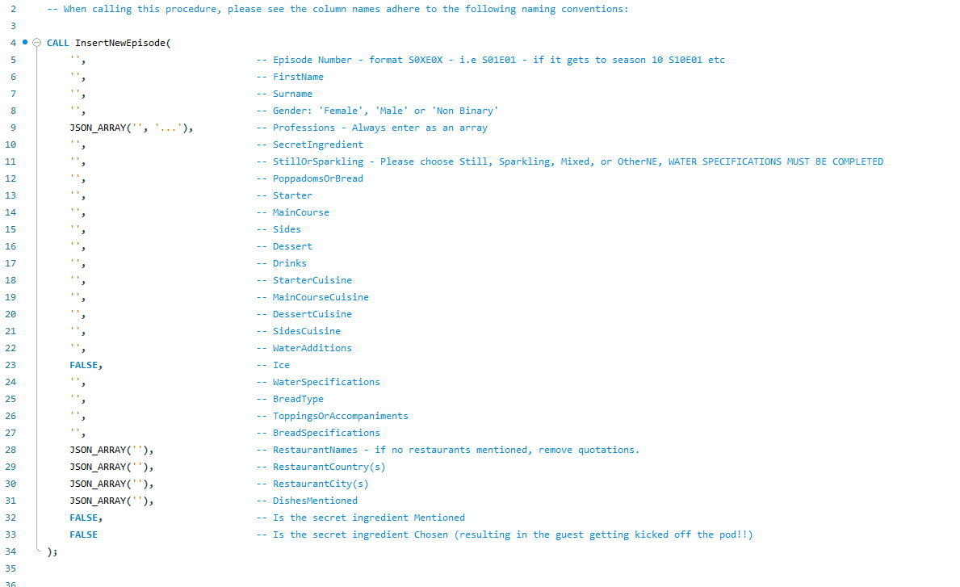
The mega procedure guide.
Notes:
As this procedure asks for a huge amount of data, documentation is important so I created a guide to help input the values.
I utilised this along with ChatGPT to help me fill in the procedure call for each episode.

Slide 9
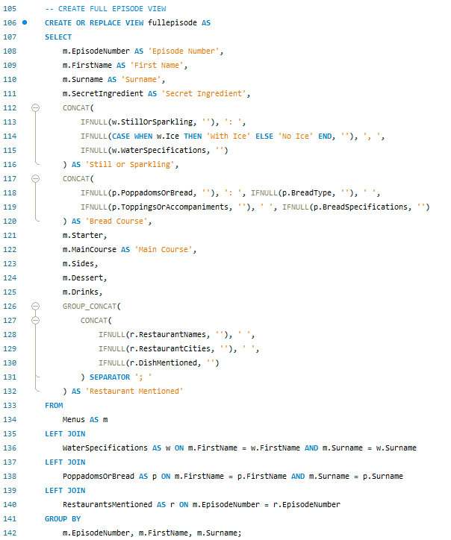
Creating a view
Challenges:
Combine multiple columns in a single column.
What if there are no values?
How do I want to display the information?
Solutions:
Use a combination of CONCAT and IFNULL
Use LEFT JOINS, in order of what you want to see.
Notes:
I wanted to create a view that would provide a snapshot of an episode but didn’t necessarily want all of the columns created.
I utilised Left joins as I wanted all entries from the initial tables and wanted to show a null value if there was nothing in the later restaurant/cuisine columns.
To make the bread and water columns concise, I utilised CONCAT to join them and IFNULL, which would check if the column was blank, and if it was, return an empty string to help with formatting.
In Restaurants, I utilised GROUP_CONCAT as this was concatenating different rows, not columns.

Slide 10
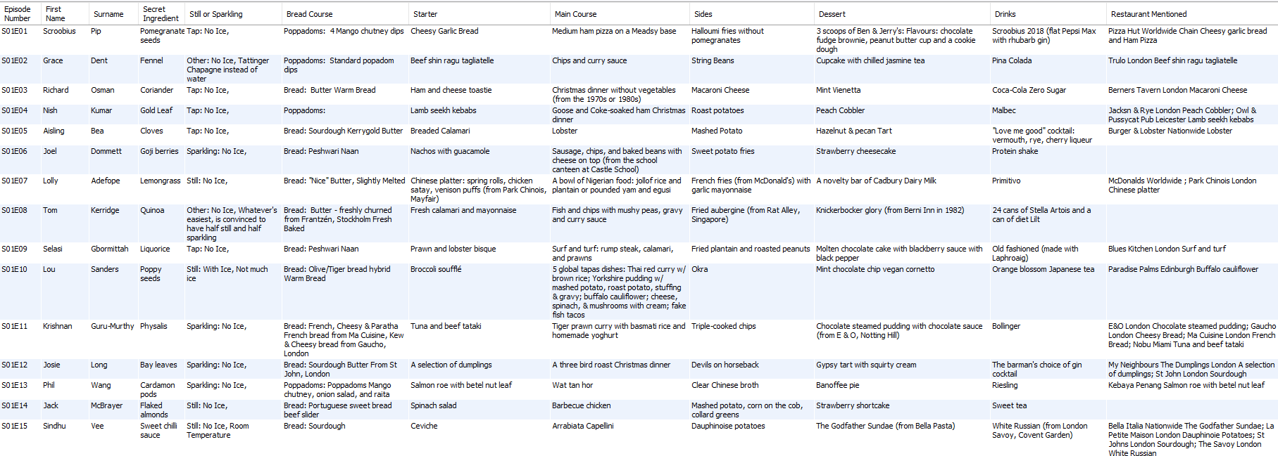
The View
Notes:
This is how it looks.

Slide 11
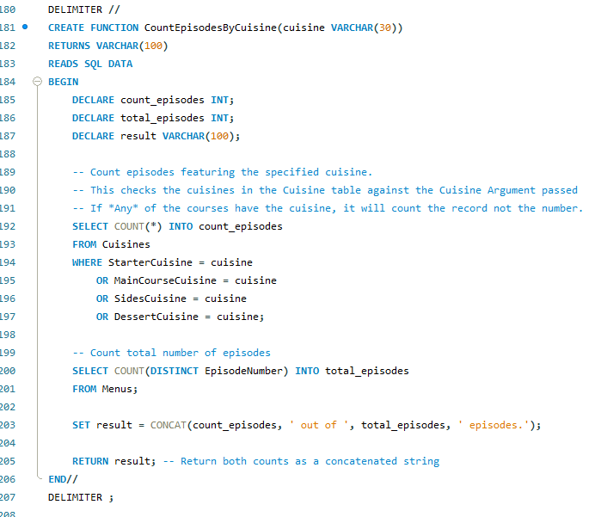
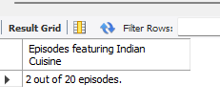
Function.
Output.
Notes:
One of the main things that interested me was seeing the types of cuisines mentioned in the episodes so I created a function to check this.
The logic in this function made sure that even if a cuisine was mentioned multiple times in an episode, it would only count the episode itself by using OR in my WHERE statement.
When calling it, I made use of an Alias to make the column name look prettier!

Slide 12
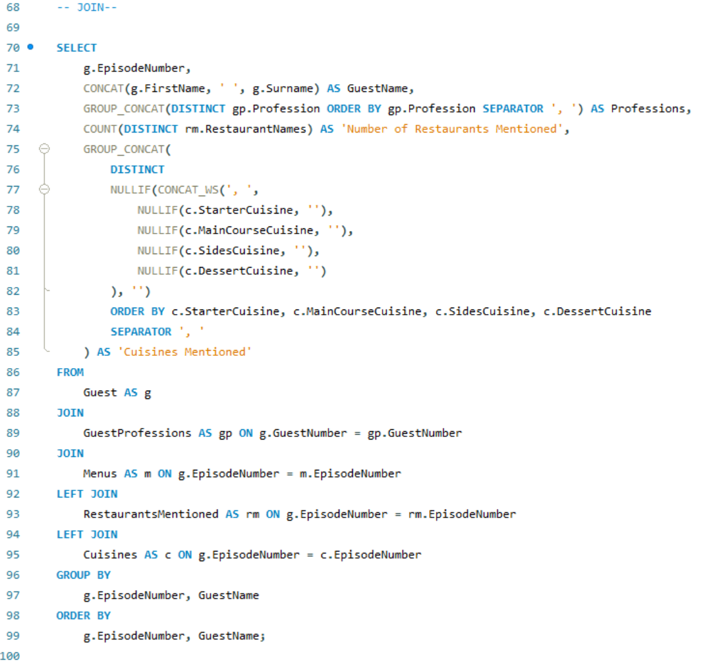
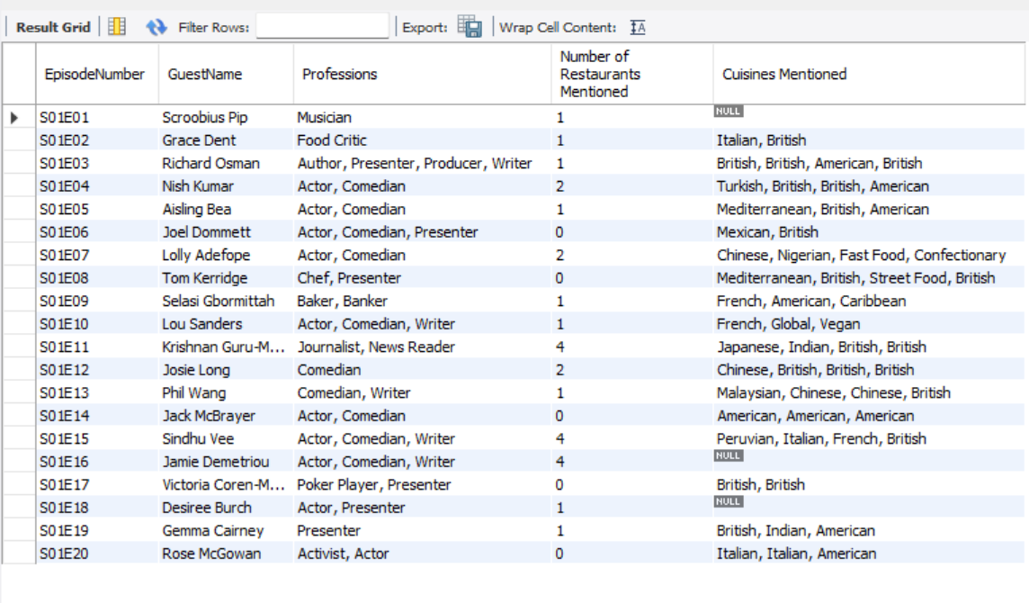
Join
Notes:
This was my standalone join statement where I joined a number of columns for a smaller snapshot – this could easily be turned into a view!

Slide 13
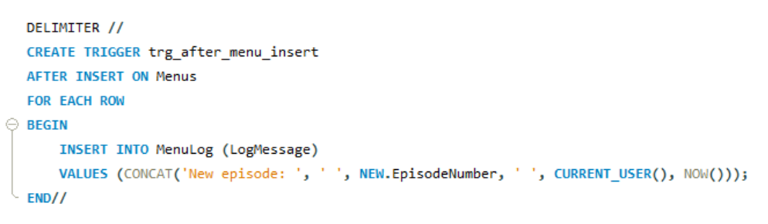
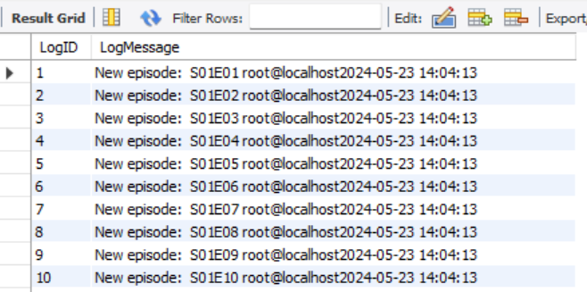
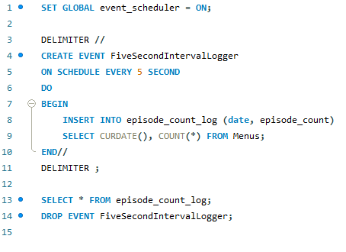
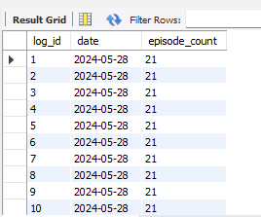
Trigger
Event
Notes:
I created a trigger to log every time an episode is logged, which displays the log ID, and message with the episode number, who logged it in and a timestamp.
With the event, I tried to get this to be an auto-backup (which I am still working on!) but to evidence, I understood the concept, I created (and quickly dropped!) and episode count event that checked the number of episodes in the database at 5 second intervals. As I didn’t want to crash my whole system I dropped after about a minute!

Slide 14
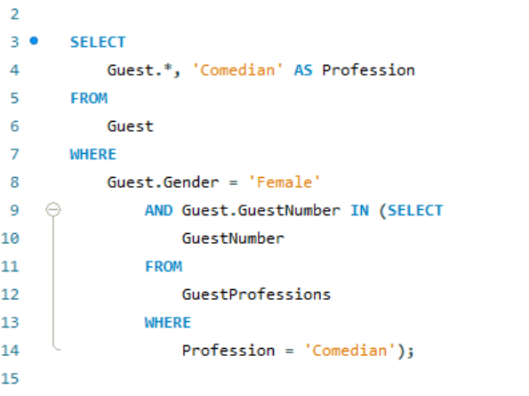
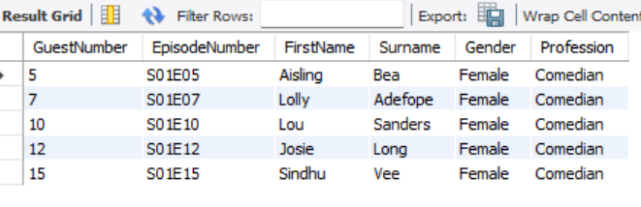
Subquery
Displays all female guests where one of their professions is Comedian.
Query
Output
Notes:
In this Subquery – which could be adapted for any profession, I was interested in how many female guests were comedians. This was across 2 tables so I used a subquery as above to display this.

Slide 15
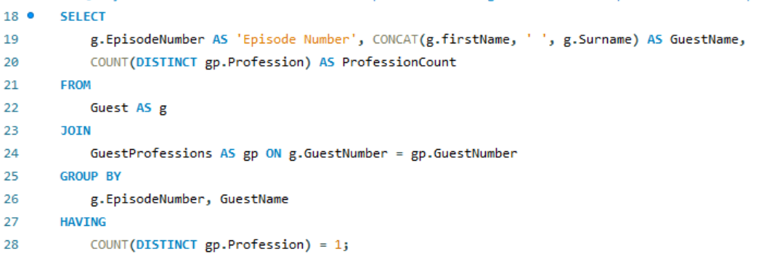
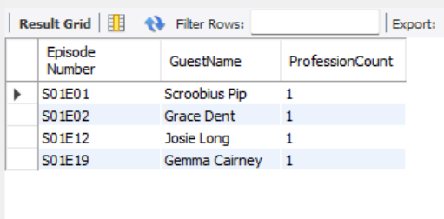
Group by & Having
Group by & Having query that displays guests with only 1 profession
Query
Output
Notes:
I also found that most of the guests had multiple professions (which is why I had a separate professions table) but I wanted to see how many of those input only had 1.
I achieved this my utilising a query using a join, with Group by and Having to display this in a clear manner.

Slide 16
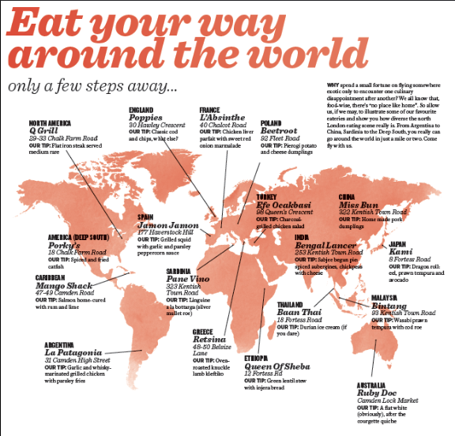


What’s Next!
Drinks – Add separate drink categories/cocktails/bars mentioned/soft vs alcoholic!
Geotags – learn how to create fun visualisations!
Create an event for an auto-backup.
Continue learning SQL!
Notes:
Drinks – As I got into reviewing and analysing the data I realised having separate drinks fieds would be super helpful. It would be great to see who liked wine, who liked beet – what was the percentage of people who don’t drink alcohol?!
Geotags – add the lat and long of each restaurant so I can get into learning visualisation with Power BI (I tried and the servers drove me nuts!) and display a but like this!
Auto back-up – automate this using an event to schedule this for added security of data.

Slide 17
The mega procedure - a (Quick!) Demo
Notes:
I was then going to go on to do a quick demo of the mega procedure preloaded with S02E01
I was going to run the view, run the procedure, then run the view with the new episode added to demonstrat – I have included a file with the code all added to show you!

